Slide 1
Next-Gen Curriculum Design: Exploring the Potential of Generative AI
Joanna Palmer, PhD, South University,
Associate Vice Chancellor for Online Learning & Innovation
Kelly Clark, MEd: Baker College,
Director of Instructional Design

Slide 2
Primary Objective
Increase knowledge and ability to leverage generative AI successfully into curriculum development, review, and revision to create more engaging, personalized, and creative learning experiences.

Slide 3
Let’s Hear From You
1)…you have used Gen AI to assist with work or projects?
2)...you have used Gen AI specifically to assist with course development.

Slide 4
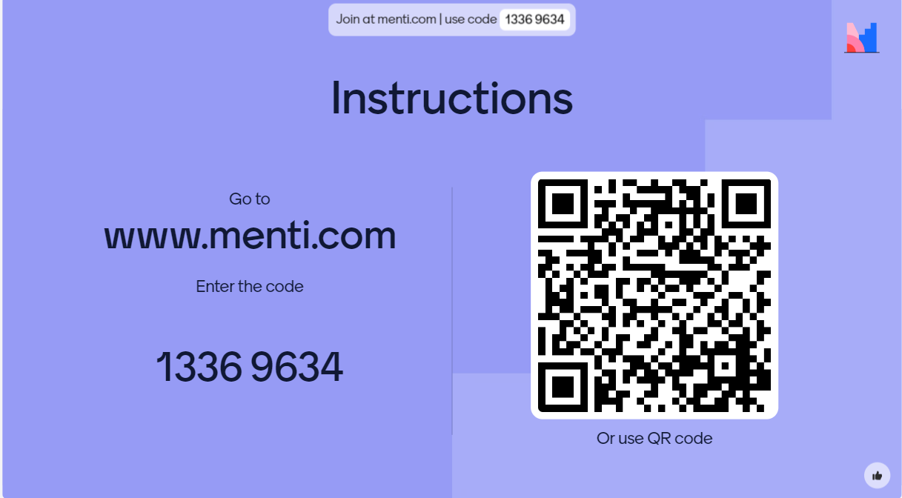
Let’s Hear From You

Slide 5
Session Overview
Introduction
Gen AI and Instructional Design Use Cases
Examples and Outputs
Lessons Learned and Prompt Generation Tips

Slide 6
Generative AI and Human Interaction
Visible Output
Above the waterline represents the output that users see and interact with.
Adaptation & Navigation
The water itself that the iceberg is in symbolizes the vast environment in which the interaction takes place. Navigating the complexities of the environment is essential. This could be regulations, guidelines, and building best practices for responsible use of AI.
Data & Learning
Below the waterline symbolizes the vast amount of data and learning processes that power the generative AI. It is not visible to the user, but it is crucial to understanding how AI functions.

Slide 7
Where Does Gen AI Fit in the Process?
Gen AI can be an additional contributor to the collaborative relationship between ID and SME
Instructional Designer
Brainstorming
Drafting
Feedback Loops
Refining
Gen AI
Subject Matter Expert

Slide 8
Gen AI Use Cases for Instructional Design
Brainstorming
Alignment
Course & Lesson Outlining
Content Drafting & Creation
Assessments & Assignments
Rubrics & Feedback

Slide 9
Understanding By Design - Backwards Design
Stage 1: Identify Desired Results
Stage 2: Determine Acceptable Evidence
Stage 3: Plan Learning Experiences & Instruction

Slide 10
Stage 1: Identify Desired Results
Brainstorm Goals, Big Ideas, & Essential Questions
Generate outcomes
Create objectives that align to outcomes
Gen AI can assist with brainstorming, drafting, alignment to appropriate level (i.e. Bloom’s Taxonomy), alignment to goals and big ideas, and refining outcomes for rigor and relevance.

Slide 11
Stage 1: Example
ChatGPT
1) Big Ideas and Essential Questions:
Big Idea 1: Critical Thinking and Analysis
Essential Question: How can critical thinking skills be applied to analyze and evaluate complex texts and arguments effectively?
Big Idea 2: Communication and Expression
Essential Question: What are the essential elements of effective written and verbal communication, and how can they be used to express ideas clearly and persuasively?
Big Idea 3: Rhetorical Awareness
Essential Question: How do writers and speakers use rhetorical strategies to engage, persuade, and influence their audience, and how can we critically analyze these strategies?
Big Idea 4: Research and Information Literacy
Essential Question: How can we locate, evaluate, and synthesize information from various sources to support our own arguments and ideas effectively?
Prompt
You are an expert instructional designer using the Understanding By Design model. Your task is to use your expertise in the Understanding By Design model to create the following items for a first-year, college-level course in Composition and Critical Thinking. 1) At least four Big Ideas and Essential Questions (as defined by the Understanding By Design model) for the Composition and Critical Thinking Course. 2) A concise, one-paragraph course description for the course based on the primary items that students should be able to know and do after the course. 3) Student Learning Outcomes based on the Big Ideas and Essential Questions that align to 3rd, 4th, 5th levels of Bloom's Taxonomy. Student Learning Outcomes should have only one verb and should not begin with "Understand".

Slide 12
Stage 1: Example Continued 1
Course Description:
In this first-year college-level Composition and Critical Thinking course, students will develop essential skills in critical analysis, effective communication, and rhetorical awareness. Through the exploration of various texts and arguments, students will learn to analyze, evaluate, and construct persuasive arguments while honing their abilities to express ideas clearly and coherently. Emphasis will also be placed on developing research and information literacy skills to support evidence-based argumentation. By the end of the course, students will be equipped with the tools necessary to engage critically with complex texts and ideas, both in academic and real-world contexts.
Student Learning Outcomes:
Analyze texts and arguments to identify underlying assumptions, biases, and logical fallacies.
Construct well-organized and persuasive written and oral arguments using appropriate evidence and rhetorical strategies.
Evaluate the credibility and reliability of sources and information to support arguments effectively.
Synthesize information from multiple sources to develop nuanced and well-supported arguments.

Slide 13
Stage 1: Example Continued 2
Student Learning Outcome 2: Construct well-organized and persuasive written and oral arguments using appropriate evidence and rhetorical strategies.
Enabling Objectives:
Develop a clear thesis statement that encapsulates the main argument of a written or oral presentation.
Organize ideas and supporting evidence logically to strengthen the coherence and persuasiveness of arguments.
Utilize rhetorical strategies such as ethos, pathos, and logos to appeal to different audiences effectively.
Incorporate relevant and credible evidence from various sources to support arguments convincingly.
Student Learning Outcome 3: Evaluate the credibility and reliability of sources and information to support arguments effectively.
Enabling Objectives:
Assess the authority and expertise of authors or sources by examining their credentials and affiliations.
Evaluate the currency of sources to determine their relevance and applicability to the argument at hand.
Scrutinize the objectivity and potential biases of sources by analyzing their tone, language, and agenda.
Cross-reference information from multiple sources to verify accuracy and reliability before incorporating them into arguments.
Prompt
Using the student learning outcomes, create 3-4 enabling objectives for each of them. Do not use the word “Understand” since this is not a measurable verb and select one verb for each objective.

Slide 14
Stage 1: Prompt Ideas & Tips
Ask the AI model to role play a persona
Set specific parameters
Use exclusions and identify contingencies, e.g. Do not use the word “Understand”
Chunk requests
Clarify what you are asking for if you don’t get the response you are looking for
Refer back to the answers the Gen AI model provided you to ask for additional information

Slide 15
Stage 2: Determine Acceptable Evidence
This stage includes determining evidence needed for the desired results (assessments) and the tools to determine if the desired results are achieved (rubrics, exemplars, etc.)
Gen AI can be leveraged in multiple ways
Brainstorming formative and summative assessment ideas.
Creating drafts of assessments, including variations of similar assignments such as case studies and test bank questions.
Creating drafts of rubric language
Assisting with feedback content and tone

Slide 16
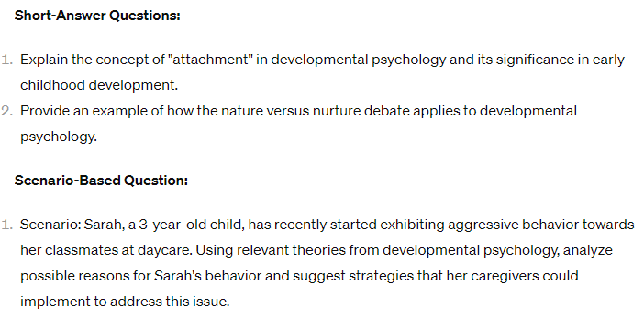
Stage 2: Assessment Examples
Prompt
Design an assessment for the end of a learning module on Developmental Psychology. Bloom's Taxonomy levels to include are understanding and applying. The assessment should include multiple-choice questions, short-answer questions, and a scenario-based question to thoroughly assess learner competency.

Slide 17
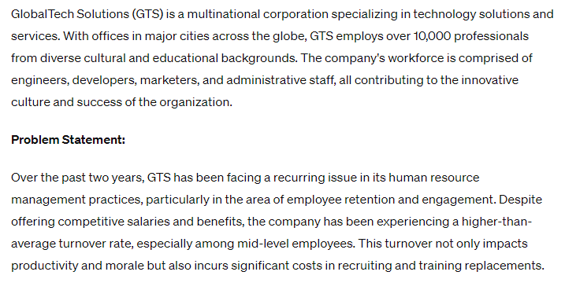
Stage 2: Case Study Example 1
Prompt - Create Case Study Draft
You are an expert in instructional design and human resource management. Create a detailed case study about a fictitious organization that assesses the following outcome - "Leverage key terms, theories/concepts and practices within the field of human resource management to develop innovative solutions to common personnel problems within organizations." Include details about the organization characteristics and demographics as well as outline the problem, who is involved, how long it has been going on, and the impact it is having on other employees and the organization.

Slide 18
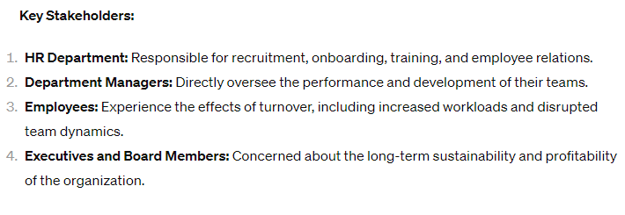
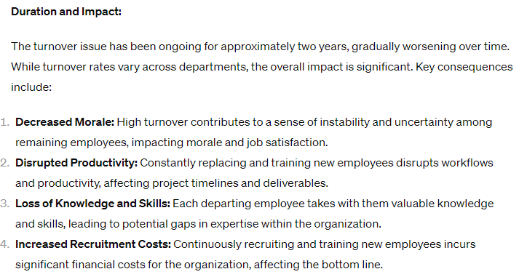
Stage 2: Case Study Example 1, cont.

Slide 19
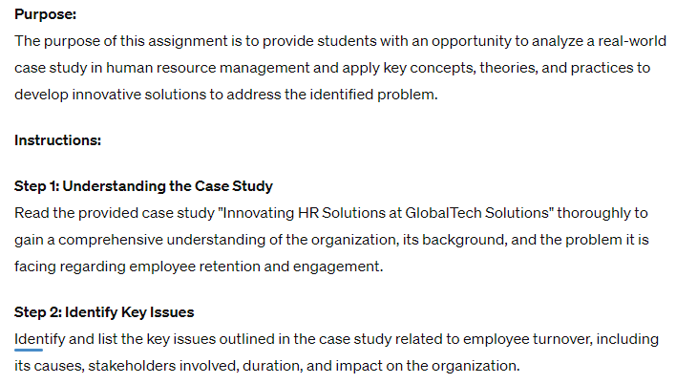
Stage 2: Case Study Example 2
Prompt - Create Case Study Assignment Directions
You are an expert instructional designer. Create assignment directions for a case study project for college level students in a human resources course based on the case study shared at the end of this prompt. Include the purpose of the assignment, the steps to successfully complete the assignment, and the specific formatting and reference details. Use the following case study: [INSERT ENTIRE CASE STUDY IN QUOTATIONS].

Slide 20
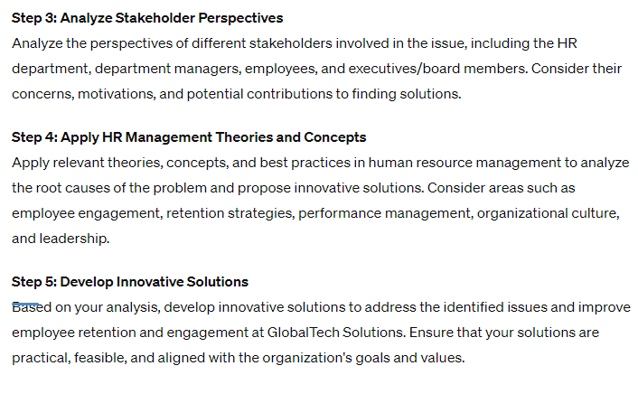
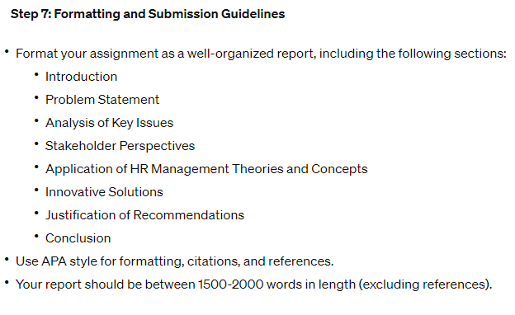
Stage 2: Case Study Example 2, cont.

Slide 21
Stage 2: Assignment Rubric Example
Prompt; Business Course
Create a 4 performance-level analytic rubric based on the following assignment directions: The Marketing Research Paper should demonstrate your knowledge of the materials (texts, assignments, and discussions) covered in this course. This paper will be submitted in two parts and must be in APA format.
Assignment Directions: You must select a publicly traded company that has a strong marketing and brand strategy such as Coke, Disney, Amazon, etc. You will assume the role of both a Marketing Manager and Marketing Consultant for this organization. You will apply your critical thinking skills and the knowledge you have acquired throughout this course and address the following in your paper:
Provide some historical information about the organization as well as their Mission and Vision Statements
Given the organization you selected, describe the products and services they offer to customers.
Identify the organization’s Target Market.
Explain how their products/services are segmented in the marketplace?
In terms of the Marketing Mix (Four P’s - Product, Promotion, Place, and Price), please address each area based on the product/service this organization offers.

Slide 22
Assignment Directions for Rubric Prompt Continued
Identify the competitors of this organization as well as what percentage of the market they possess.
Create a positioning grid and plot where the organization is positioned as well as their top competitors.
In terms of product differentiation, explain how this organization differs from the competitors you listed on the Positioning Grid? (Indicate what they do differently that makes them stand out)
Conduct a SWOT Analysis on your selected organization and list at least three items for each category.
Paper specific criteria - pages, double-spaced, APA, 5 references, etc.
Must be 5-7 pages, double-spaced, and formatted according to APA style as outlined in the Baker College (not including the title and reference pages).
Must include an APA Style Title Page and Reference Page
Must begin with an introductory paragraph that has a succinct thesis statement.
Each subsequent paragraph should contain at least 3 complete sentences of original content with supporting references outside academic sources. All references used should be cited on the final page in APA format.
Must use include 5-7 references that are listed in APA style, including your textbook.

Slide 23
Stage 2: Rubric Example - In Progress
Criteria | Exemplary | Proficient | Basic | Below Basic
Criteria 1: Content Mastery | Demonstrates comprehensive understanding and application of course materials, including texts, assignments, and discussions. Provides thorough and detailed historical information about the selected organization, including Mission and Vision Statements. Clearly describes the products and services offered by the organization, demonstrating a deep understanding of their offerings. Identifies the organization's Target Market and explains how they are effectively targeted. Provides a detailed explanation of how the organization's products/services are segmented in the marketplace, showcasing advanced knowledge of market segmentation strategies | Demonstrates a solid understanding and application of course materials, providing relevant information about the selected organization and addressing the assignment prompts adequately. | Demonstrates a basic understanding of course materials, providing some information about the selected organization but lacking depth or insight. | Demonstrates limited understanding of course materials, providing minimal or inaccurate information about the selected organization.

Slide 24
Stage 2: Rubric Example - In Progress 2
Criteria 2: Analysis and Critical Thinking | Analyzes each component of the Marketing Mix (Four P’s) thoroughly, providing insightful insights and connections to the organization's products/services. Identifies competitors and accurately assesses their market share, demonstrating a deep understanding of industry dynamics. Creates a detailed positioning grid, accurately plotting the organization and its top competitors and providing strategic insights into their positioning. Articulates a clear and compelling explanation of how the organization differentiates itself from competitors, showcasing advanced critical thinking skills and strategic insight. | Analyzes components of the Marketing Mix and competitors with some depth, but may lack thoroughness or insight in comparison to exemplary performance. | Provides a basic analysis of components of the Marketing Mix and competitors, but may lack detail or specificity. | Provides minimal analysis of components of the Marketing Mix and competitors, lacking detail, relevance, or accuracy.

Slide 25
Stage 2: Rubric Example - In Progress 3
Criteria 3: SWOT Analysis | Conducts a comprehensive SWOT Analysis on the selected organization, identifying and analyzing strengths, weaknesses, opportunities, and threats with depth and insight. Lists at least three items for each category of the SWOT Analysis, demonstrating a thorough understanding of the organization's internal and external environment. Provides strategic recommendations based on the findings of the SWOT Analysis, showcasing advanced analytical skills and strategic thinking. | Conducts a SWOT Analysis with competence, identifying strengths, weaknesses, opportunities, and threats, but may lack depth or strategic insight in comparison to exemplary performance. | Conducts a basic SWOT Analysis, identifying some strengths, weaknesses, opportunities, and threats, but may lack depth or thoroughness. | Conducts a superficial or incomplete SWOT Analysis, failing to identify or analyze key factors effectively.

Slide 26
Stage 2: Rubric Example - In Progress 4
Criteria 4: Paper Requirements | Meets all paper requirements, including length (5-7 pages), formatting (APA style), and inclusion of an APA Style Title Page and Reference Page. Begins with a clear and concise introductory paragraph that sets the stage for the paper and includes a well-defined thesis statement. Each subsequent paragraph contains at least 3 complete sentences of original content supported by outside academic sources, cited in APA format. Includes 5-7 references, including the textbook, listed in APA style on the reference page. | Meets most paper requirements, but may have minor issues with formatting, organization, or clarity. | Meets some paper requirements but may have significant issues with length, formatting, or clarity. | Fails to meet multiple paper requirements, such as length, formatting, organization, or clarity.

Slide 27
Stage 2: Prompt Ideas & Tips
The more information you provide in your descriptions, the more likely you’ll see accurate and salient content.
Refining prompts through conversation to add and remove additional detail and qualifiers can improve output.
Prompt chaining can be helpful to provide better output (the output from one prompt serves as the input for the next, creating a sequence of prompts that lead to the final result).

Slide 28
Stage 3: Plan Learning Experiences & Instruction
Create lesson plans
Break down complex lessons into smaller parts
Generate a variety of in class activities and discussions that provide opportunities for practice and formative assessment
Convert lessons, content, and activities to work in different modalities

Slide 29
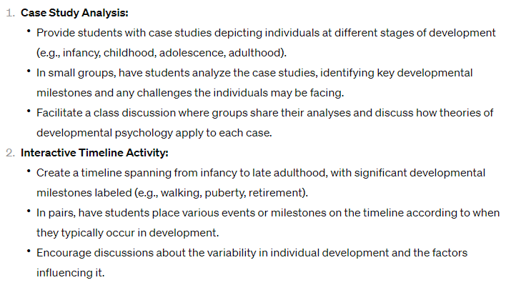
Stage 3: Learning Activity Example
Prompt
Based of the Developmental Psychology Assessment Prompt earlier. In the conversation, once the assessment has been generated, you can input supplemental prompts.)
- Create 5 in class learning activities AND discussions that a teacher can use to prepare students for the assessment above.

Slide 30
Stage 3: Modality Modification Example
Supplemental Prompt
Revise the items you created to work for a fully online asynchronous learning environment.

Slide 31
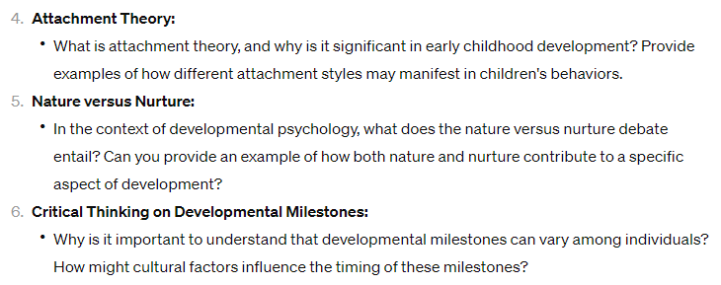
Stage 3: Discussion Example
Supplemental Prompt
Create 10 specific discussion questions that provide practice, and formative assessment of knowledge and skills, and prepare the student for the original assessment you created.

Slide 32
Stage 3: Lesson Plan Example
Prompt (for live/synchronous class)
You are an expert instructional designer. Design a lesson plan for a three-hour class teaching the concept of nature versus nurture to college students. Include learning objectives for each level of Bloom’s Taxonomy: [knowledge, comprehension, application, analysis, synthesis, and evaluation]. Include [individual, small group, and whole class] components. Create formative assessment activities for each of the learning objectives.

Slide 33
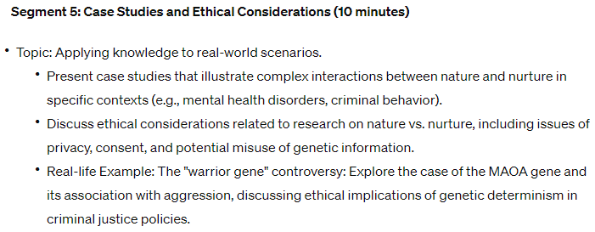
Stage 3: Lecture Outline Example
Prompt (based on previous slide)
Create a lecture outline that teaches college-level students how to 1) analyze empirical evidence supporting both nature and nurture arguments, and 2) evaluate the strengths and weaknesses of different perspectives on nature vs. nurture. Break down the lecture into five, 10-minute segments. Include topics to cover, a brief summary of each component, and include real life examples.

Slide 34
Stage 3: Prompt Ideas & Tips
Leverage the conversation you can have with the Gen AI tool to refine the content, make the content more concise, expand output, etc.
Include learning objectives as part of the input
Inputs: Topic(s), Learning Objectives, target audience, essential elements to include, contingencies and items to exclude.

Slide 35
Stage 3: Prompt Ideas & Tips
Inputs: subject area, audience, and learning objectives
Example: You are an expert in generating innovative learning module topics and instructional design. Based on the subject area of [INSERT], the target audience of [high school students, college students, etc.], and the learning objectives of [INSERT], suggest 5 essential topics.
Include instructional frameworks and models (ADDIE, UbD, etc.) to help focus the type of output you receive.
EXAMPLE: “You are an expert instructional designer using the [specific instructional design model]. Your task is to create a lesson plan for the module titled [Module Title]. This module is part of a broader course aimed at [Target Audience].
Adapted from 25+ Best ChatGPT Prompts for Instructional Designers (thinkific.com) Author: Colin Burton June 26.2023

Slide 36
Let’s Try A Few Together
Design an assessment for the end of a learning module on [INSERT TOPIC] from an [INTRODUCTORY OR ADVANCED] level college course in [INSERT COURSE NAME]. The three Bloom's Taxonomy levels to include are [IDENTIFY 1) understanding, application, analysis, evaluation, creation]. The assessment should be authentic to real life and propose a complex problem that needs a solution. Provide detailed instructions for completing the assessment.
ChatGPT (openai.com)

Slide 37
Best Practices & More Tips
Be specific and detailed with your prompt
Include context (frameworks, the role the GenAI is approaching the task from), state the primary task, and identify contingencies
Iterative Conversation: “Test, tweak, and redeploy”to continue to refine output
Prompt chaining - Using the output from one prompt as part of the input for the next prompt
Guides Gen AI through smaller more manageable tasks to achieve a complex goal/output
Do not be afraid to just experiment, start somewhere, and see how the conversation unfolds
Ask the Gen AI tool to make your prompt better before you ask it to complete the task
Improve this prompt to maximize the creativity and analytical abilities of a large language model: [Insert prompt in quotation marks]
Use numbers or spacing to help AI pay attention to different aspects of a prompt
Treat it like a new intern - it’s impossible to provide too much information

Slide 38
Benefits of Leveraging GenAI
Increased productivity through collaboration between ID-SME-Gen AI
Reduces the burden on SMEs to create and draft all content from scratch.
Output can be reflective of more diverse ideas and perspectives
Helps create personalized and inclusive learning experiences
Saves time and money

Slide 39
Resources
25+ Best ChatGPT Prompts for Instructional Designers (thinkific.com)
ChatGPT for Instructional Design: Unleashing Game-Changing Tactics - Teachfloor Blog
Prompt Library — AI for Education
Designing Assignments and Activities with ChatGPT and Generative AI in Mind – Teaching Resources (ncsu.edu)
ChatGPT Prompts for Instructional Designers - Teachfloor Blog
8 Tips and Tricks for Better Results from Your AI Prompts
15+ Rules for Crafting Effective GPT Prompts

Slide 40
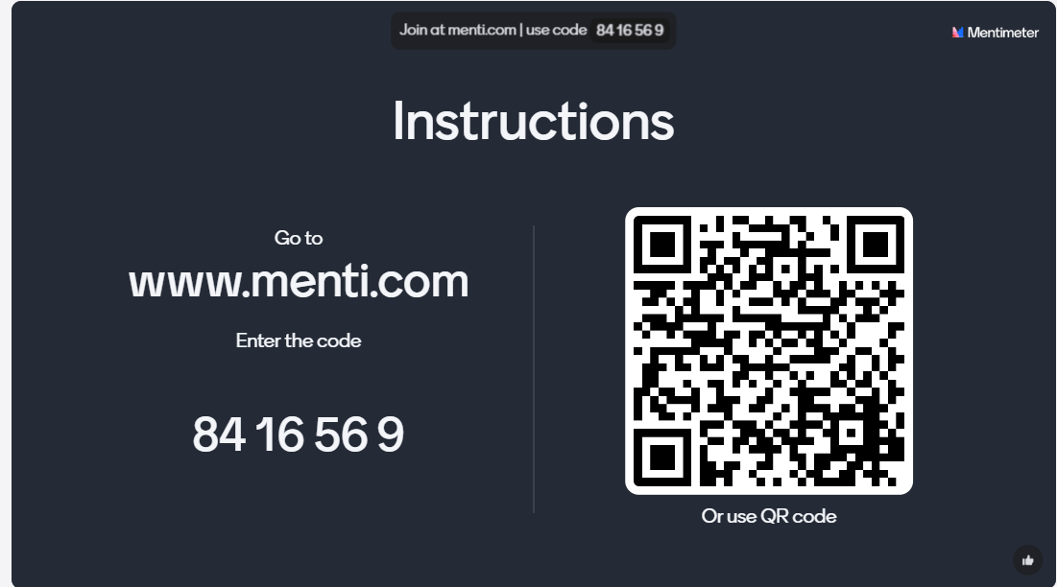
Let’s Hear From You Again

Slide 41
Joanna Palmer
jpalmer@southuniversity.edu
Kelly Clark
kelly.clark@baker.edu

