Slide 1
2019 A4EOE Survey
Results and Roundtable Discussion
Diane Cairns, Cairns Management, LLC, Principal
Shaun Moore, Director of e-Learning, Oakland University

Slide 2
Agenda
National Trends
Regional Trends
“Your Current Challenges” Roundtable Session

Slide 3
A4EOE Mission Statement
“The Alliance is a coalition of members from educational institutions, vendors and corporate partners dedicated to advancing the quality of online pedagogy by continuously upgrading online educational experiences for faculty, staff and students.”
Notes:
Shaun will talk about National Trends.

Slide 4
National Trends
The Changing Landscape of Online Education (CHLOE 3) 2019
Quality Matters and Eduventures Research
Survey of 280 chief online officers from all sectors of U.S. higher education.
The majority of online courses are overwhelmingly asynchronous, though a significant number include some required or optional face-to-face sessions.
Notes:
Shaun will talk about National Trends.

Slide 5
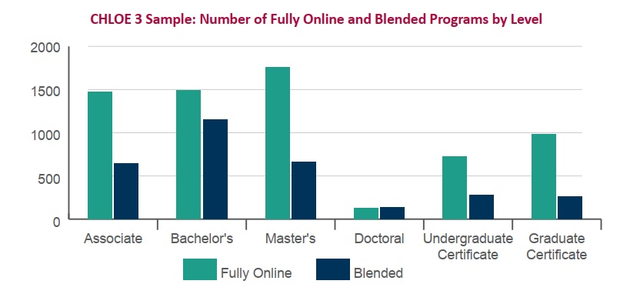
About one-third of all master’s students now study fully online, which is much higher than at any other degree level.

Slide 6
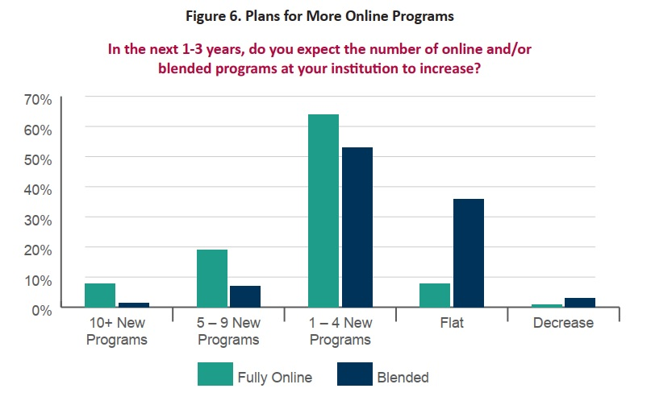

Slide 7
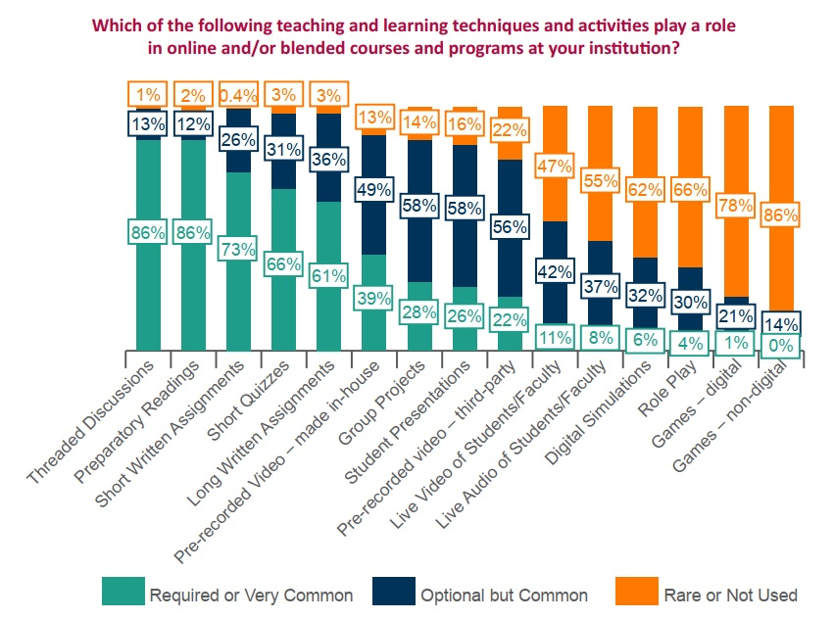

Slide 8
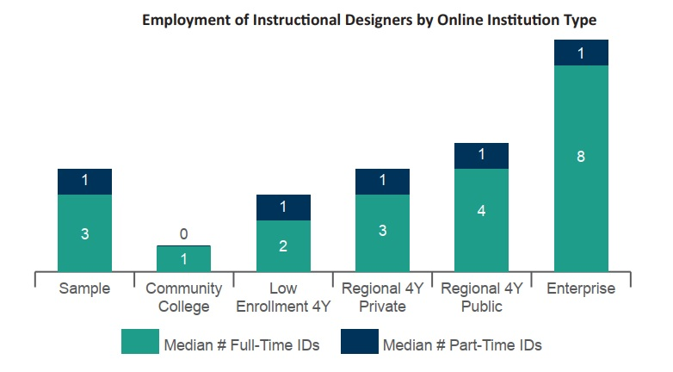

Slide 9
Regional Trends - 2019 A4EOE Survey
Support the A4EOE Mission by identifying current practices at individual institutions and reporting results and trends back to the community.
18 questions, 2 sub-questions, 4 sections
15 A4EOE contacts
12 responses returned: 2 of the responses were from the same college. These responses were consolidated.
Notes:
Shaun will introduce survey.

Slide 10
Participating Institutions
Baker College
Central Michigan University
Lawrence Technological University
Macomb Community College
Northwood University
Oakland Community College
Oakland University
Schoolcraft College
Walsh College
Washtenaw Community College
Wayne State
Notes:
Diane will start talking about survey results.

Slide 11
What online student services does your institution offer? Please list all of the different student services that are offered online, as well as the methods available for students to access those services.
Most services indicated were identified to be available via email, phone, web conference, chat, and onsite. One college offered tutoring services using Skype.
Helpdesk
Advising
Tutoring
Counseling, Advising, Health
Learning Support Services
Mental Health Testing and Intake
Emergency Services
Student Success Coach
Career Services
Financial Aid
Disability Support
Student Ambassador Program
Distance Learning Support
Testing Center
Library & Research
Veterans Services
Virtual Campus Tour

Slide 12
Do you offer the same student services to your online students that are available to your on-campus students? If not, which services are available in one modality (online, on-campus) and not the other?
Not all services are fully online. Those noted in YELLOW are more robust on-campus. A campus visit or a telephone conversation provides more robust support.
Career Services
Financial Aid
Disability Services
Student Ambassador Program
Distance Learning Support
Testing Center
Library & Research
Veterans Services
Virtual Campus Tour
Helpdesk
Advising
Tutoring
Counseling, Advising, Health
Learning Support Services
Mental Health Testing and Intake
Emergency Services
Student Success Coach

Slide 13
During what hours are online student services available?
Availability varies based on:
Department offering the service
Campus building hours
One college indicated the use of a 24/7 call service to take a message and schedule a return call for the next day.

Slide 14
What products/vendors are you using to offer any of your online student services?
NetTutor
Campus Assistance Program
Blackboard – online training, testing
Canvas - training
Zoom – web conferencing
WebEx
Skype
BlueJeans Network
TDX

Slide 15
How are students made aware of the various services provided? Please list all touch points.
Department notifications
Landing page of LMS
Email
Online Orientation
Student Coach service
LMS Community page
College Portal
College webpages
Campus Flyer

Slide 16
What services have been added over the past five years to support online students?
Campus Assistance Program
Web conferencing
Advising
Tutoring
Advising
Third party platform: supporting tutoring, improved access for student services.
Career Services
Success Coaching

Slide 17
What services do you foresee adding in the next 1-3 years to support online students?
Clinical Counseling
Career Services
Enhanced Tutoring
Realtime Chat Boxes
Virtual Tutoring Center
Enhancing Current Services
Increase Technical Support Hours
Online Chat with Tutoring and Advisors
Student Government
Student predictive Self Help Dashboard Notifications
Coaching and warnings based on individual performance / AI
AI assisting student outreach & student success coaches
Texting/IM
Veteran Support Services
Web conferencing for all Student Services

Slide 18
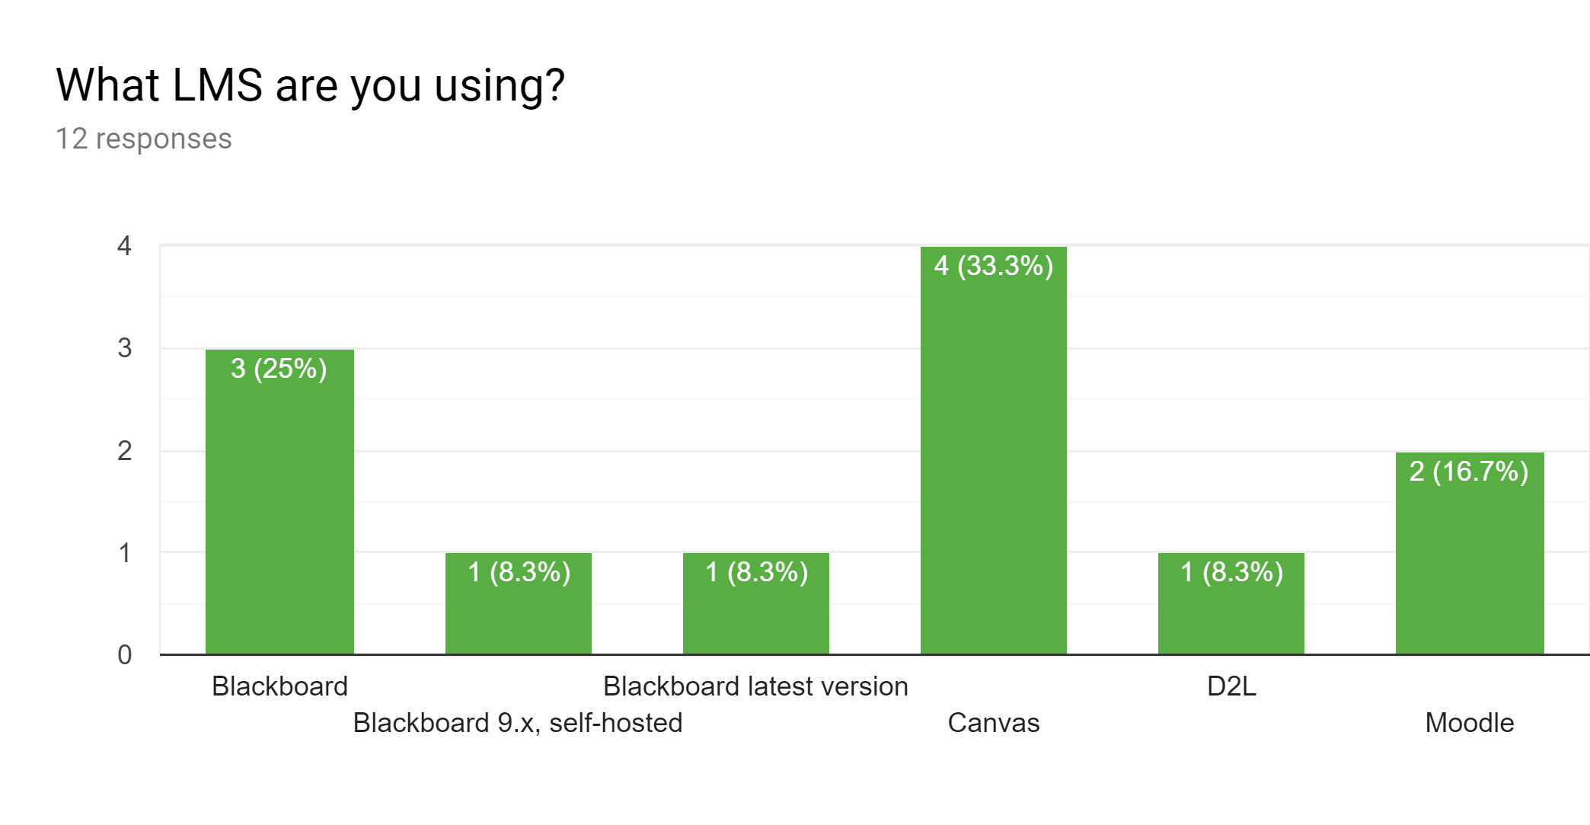
Notes:
Shaun will start talking about the data starting here with LMS.

Slide 19
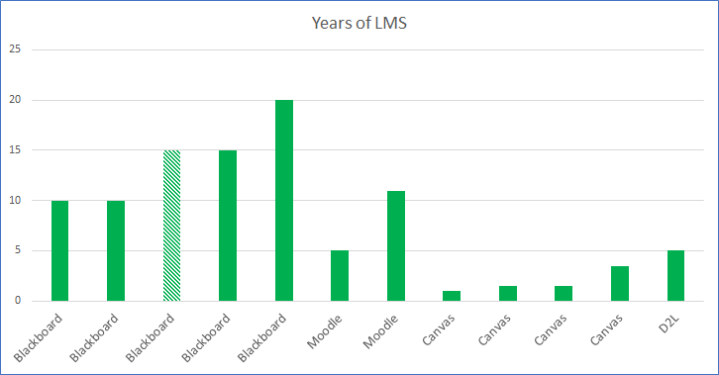
Are you considering changing to a new LMS?
How long have you used this LMS?
Eight responded NO.
Two using Blackboard responded MAYBE.
One indicated a time frame of 2 years for a change.

Slide 20
What is the name of your online learning department?
Academic Technologies
Department of Online Learning
Distance Learning
eLearning
e-Learning and Instructional Support
Office for Teaching and Learning
Office of Curriculum & Instructional Support
Online Learning
Online Learning Department

Slide 21
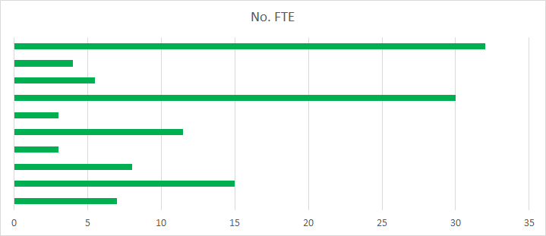
How many personnel are available (FTE)? (within Online Learning Dept.)

Slide 22
What software tools do you use to design and develop online or blended courses?
3Play Media
Adobe Cloud
After Effects
Amara
Audacity
Blackboard
Bluepulse
Camtasia
Canvas
Captivate
Dreamweaver
Echo360 Personal Capture
Examity
FinalCutPro
GoAnimate
Google Apps
Google Apps
H5P
HonorLock
MindTap
Moodle
Office 365
Office Suite
Panopto
Pearson MyLab
PhotoShop
PowerPoint
Publisher Material
Respondus
Screen-Casto-Matic
SnagIt
Storyline Agriculture
VoiceThread
Vyond Premier
Zoom

Slide 23
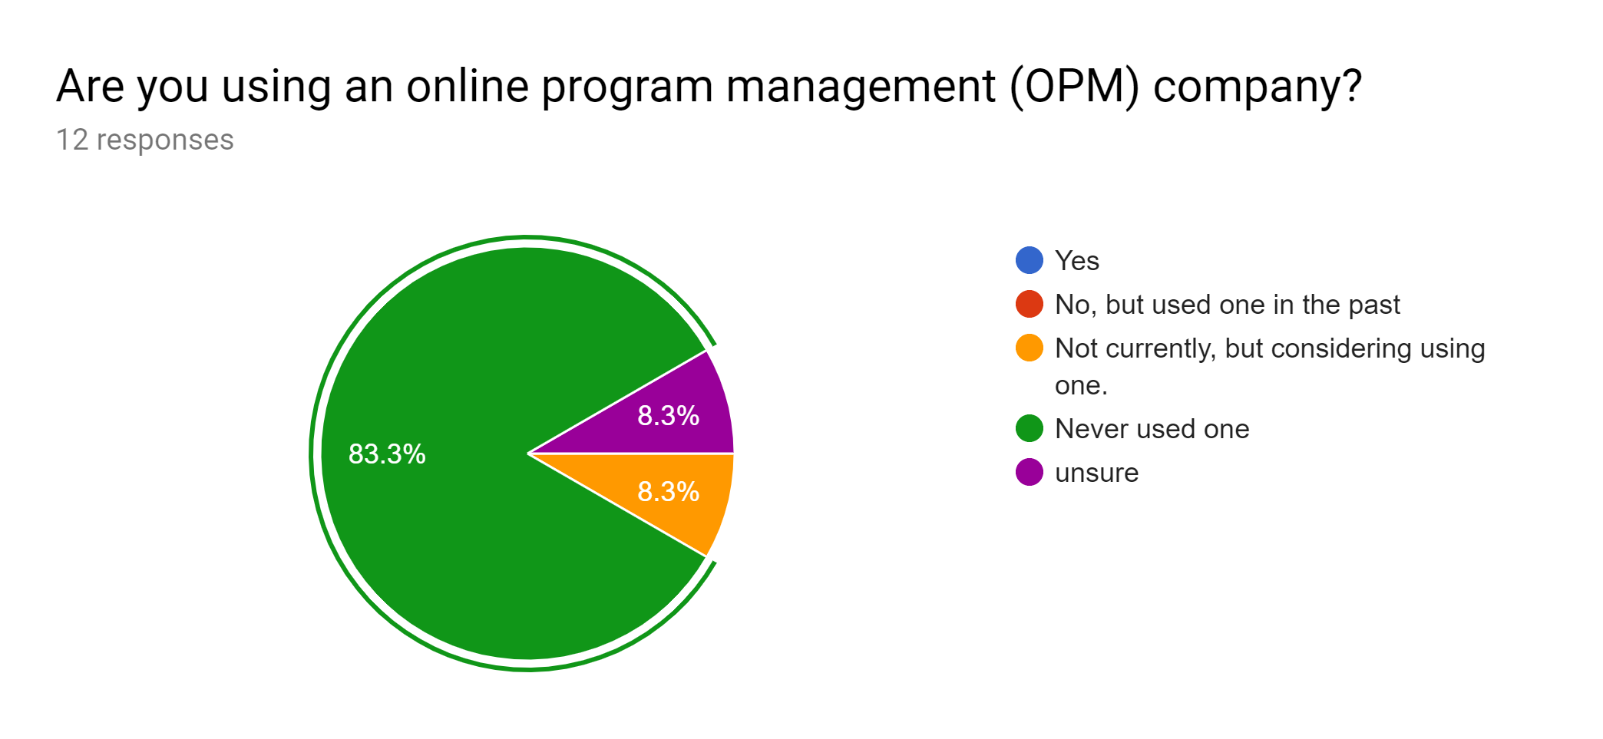
One college is considering Academic Partnerships

Slide 24
Roundtable Discussion
Notes:
Diane will think up some discussion topics.

Slide 25
Questions?
Diane Cairns - diane@dcairns.com
Shaun Moore - samoore@oakland.edu

